Slide 1

Evaluating Apple's MLX Framework for Machine Learning
A Comparative Study Using Unsupervised Clustering Algorithms
Sharan Deepak Thakur
GH1031360

Slide 2
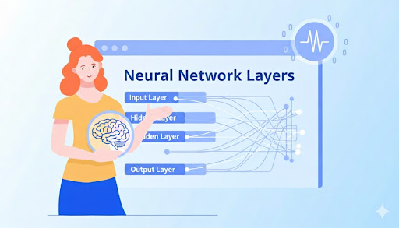
Agenda
Introduction
Literature Review
The Research Gap
Research Questions
Methodology & Conceptual Framework
Experimental Methodology
Challenges
Results
Conclusion

Slide 3
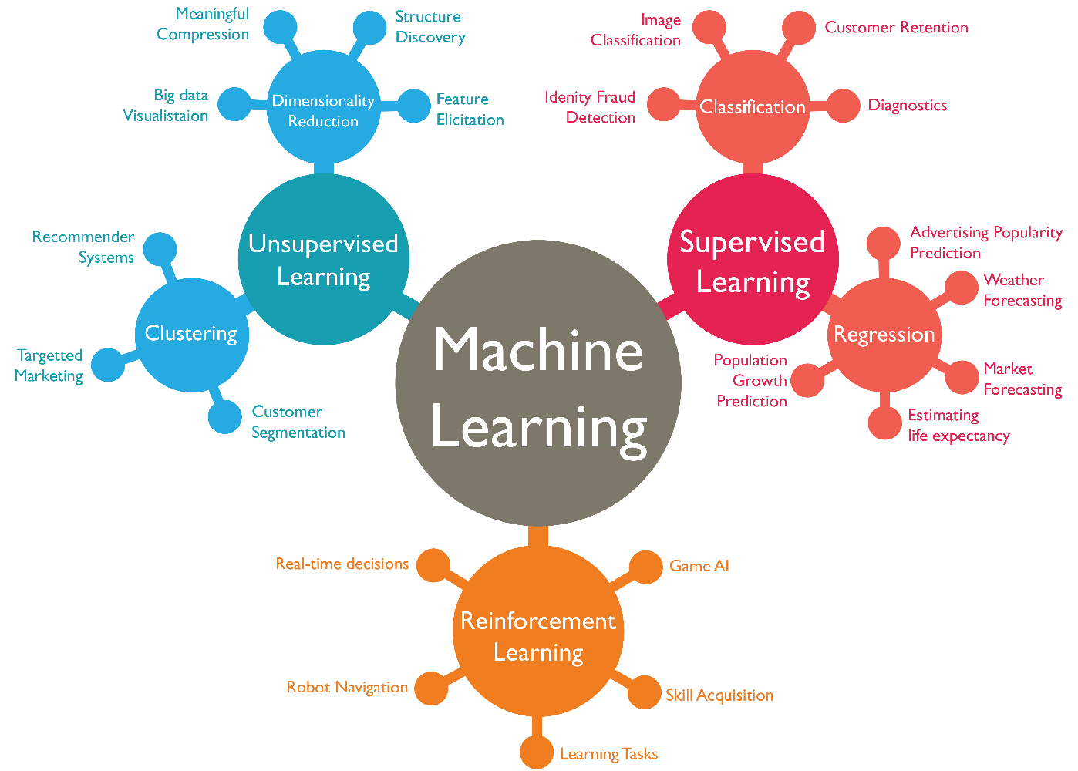


Introduction
Machine Learning
Supervised Learning
Unsupervised Learning
Clustering
Fig: Machine Learning Problems
Dan Shewan WordStream, 2023

Slide 4



The Evolution of Machine Learning Hardware
GPU-Centric Era
Apple Silicon Shift
MLX Framework
Traditional deep learning frameworks optimized for NVIDIA CUDA architecture with discrete GPU memory.
1. M-series processors
2. Unified memory architecture integrating CPU, GPU, ANE with shared pools up to 192GB.
Purpose-built array framework designed specifically to leverage Apple Silicon's unique architecture from the ground up.

Slide 5
Literature Review
Paper Author | Relevance
Awni Hannun et al., 2025 | Defines the MLX framework’s architecture, optimizations, and rationale for Apple Silicon benchmarking.
Indranil Bose & Xi Chen, 2009 | It formalizes both hybridization strategies (cluster → classifier and cluster label as feature).
Hoang Tran, Ngoc Le, Van-Ho Nguyen, 2023 | Uses K-Means for segmentation on financial data (credit card/banking).
Table: Relevant Papers
KMeans Clustering:
Hartigan and Wong. 1979, Most widely deployed unsupervised algorithm for
customer segmentation, financial analytics, and exploratory analysis
MLX Design Philosophy:
Hannun et al. 2025 designed MLX with lazy evaluation and unified memory utilization
Apple Silicon Architecture:
Feng et al. 2025 reveals comprehensive profiling unified memory eliminates CPU-GPU data transfer overhead
Notes:
Chen's research establishes KMeans as the leading technique across telecommunications and e-commerce sectors.

Slide 6
The Research Gap
Current literature overwhelmingly focuses on MLX performance for deep learning specifically LLMs and transformers.
However, a critical gap exists for traditional machine learning algorithms.
Algorithmic Diversity
Production Relevance
Notes:
Algorithm Diversity: Clustering algorithms have fundamentally different computational patterns from neural networks, relying on iterative distance calculations rather than backpropagation.
Relevance: Many organizations depend on classical ML for interpretability, lower computational requirements, and proven effectiveness with structured data.

Slide 7

Research Questions
1
O1. Performance Comparison
RQ1. How does MLX's computational performance for KMeans clustering compare to scikit-learn, NumPy, and PyTorch on Apple Silicon?
2
O2. Clustering Quality
RQ2. Does MLX produce equivalent results measured by Adjusted Rand Index, Normalized Mutual Information, and Silhouette Score?
3
O3. API Usability
RQ3. What are the primary implementation challenges when developing traditional ML algorithms in MLX given its API constraints?
4
O4. Practical Implications
RQ4. What actionable recommendations should practitioners consider when evaluating MLX for unsupervised learning workflows?

Slide 8
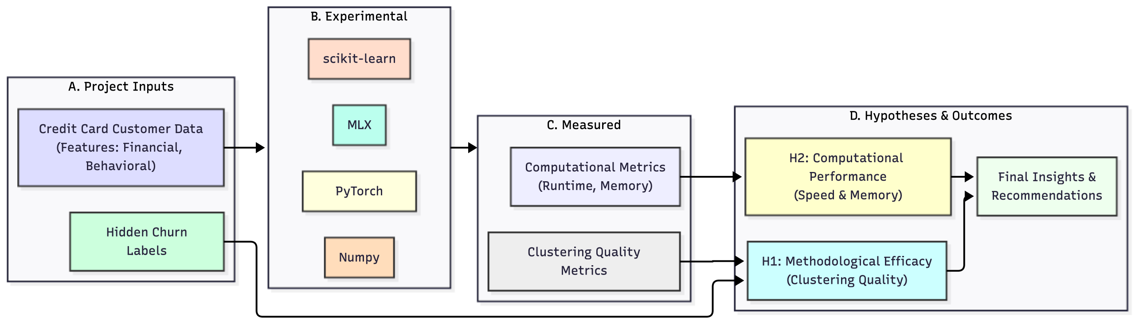
Methodology & Conceptual Framework
This framework illustrates the interrelationships between the core components of our study: the MLX framework, the clustering algorithms employed, and the various performance metrics used for evaluation.It highlights how the MLX framework processes data using these algorithms, with the results then assessed by specific metrics to understand performance and clustering quality.

Slide 9
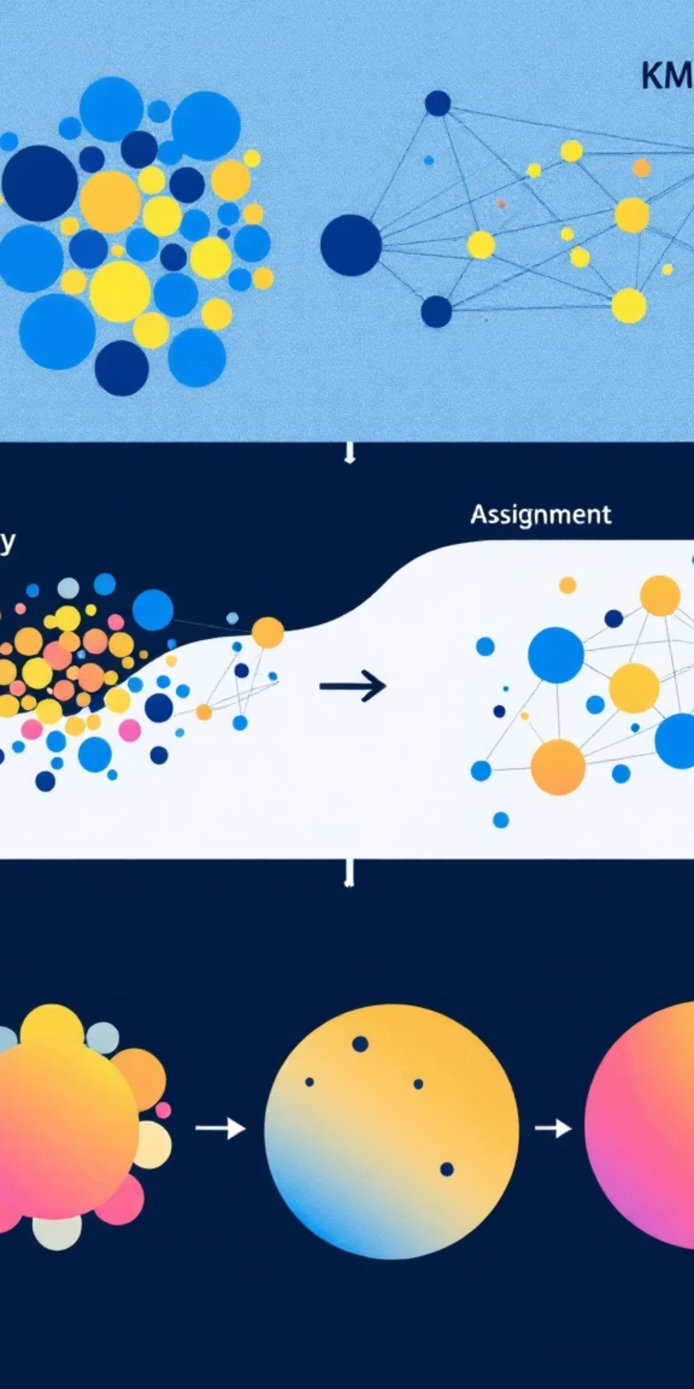

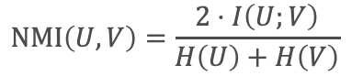
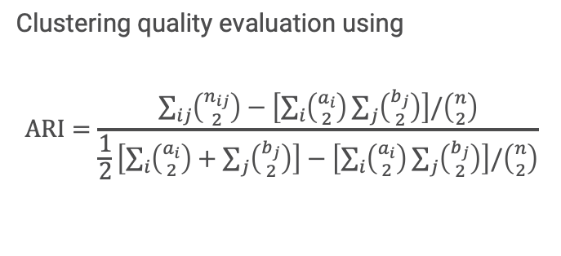
Experimental Methodology
01
Multi-Framework Implementations
Parallel implementations of KMeans across MLX, scikit-learn, NumPy, and PyTorch using identical algorithmic logic and parameters.
02
Rigorous Benchmarking Protocol
Experimental rounds following Bahrampour et al. from 2016's framework comparison methodology.
03
Controlled Environment
All experiments executed on identical Apple Silicon hardware, Python 3.11, with standardized data preprocessing and feature scaling between 0-1.
04
Comprehensive Metrics
Clustering quality evaluation using
$$\text{ARI}=\frac{\sum_{ij}{\left({n_{ij} \atop 2}\right)}−\left[\sum_{i}{\left({a_{i} \atop 2}\right)}\sum_{j}{\left({b_{j} \atop 2}\right)}\right]/\left({n \atop 2}\right)}{\frac{1}{2}\left[\sum_{i}{\left({a_{i} \atop 2}\right)}+\sum_{j}{\left({b_{j} \atop 2}\right)}\right]−\left[\sum_{i}{\left({a_{i} \atop 2}\right)}\sum_{j}{\left({b_{j} \atop 2}\right)}\right]/\left({n \atop 2}\right)}$$
$$\text{NMI}\left(U,V\right)=\frac{2⋅I\left(U;V\right)}{H\left(U\right)+H\left(V\right)}$$
$s\left(i\right)=\frac{b\left(i\right)−a\left(i\right)}{\max\left(a\left(i\right),b\left(i\right)\right)}$ $a\left(i\right)$ = mean intra-cluster distance, $b\left(i\right)$= mean nearest-cluster distance
Computational performance measured via wall-clock time with millisecond precision.
ARI: L. Hubert et al, 1985; NMI: Scikit-Learn, Silhouette Score: Peter. J.R., 1987

Slide 10
MLX Implementation Challenges
Challenge:
Challenge:
Challenge:
No Boolean Indexing
Limited Random API
Type System Differences
Problem: MLX lacks direct support for operations like X[labels==k].
Problem: No equivalent to NumPy's np.random.choice().
Problem: MLX arrays require careful type checking and explicit conversions.
Solution: Implemented mask-based weighted operations to achieve equivalent functionality.
Solution: Used mx.random.permutation() followed by slicing for centroid initialization.
Solution: Implemented comprehensive input validation and type conversion logic throughout.
These API differences reveal MLX's current difference in their array operations due to lazy computation.

Slide 11
Preliminary Results: MNIST Dataset
Configuration: 7,500 samples with 784 features, k=10 clusters, 20 experimental rounds with seeds 44-63
Clustering Quality
Performance Ranking
All frameworks achieve equivalent quality metrics within 5%. MLX achieves the highest ARI (0.3777) and Silhouette (0.0636), demonstrating superior clustering results.
scikit-learn (0.16s) > PyTorch (0.61s) > MLX (1.10s) > NumPy (2.78s). MLX achieves 60% speedup over NumPy.
ARI (Adjusted Rand Index) measures similarity between true and predicted clusters, ranging from -1 to 1, where 1 indicates perfect matching.
Silhouette Score measures how similar an object is to its own cluster compared to other clusters, ranging from -1 to 1, with higher values indicating better-defined clusters.

Slide 12
Final Results: Credit Card Dataset
Configuration: 30,000 samples with 9 features, k=2 clusters, 500 KMeans rounds with seed 44
Clustering Quality
Performance Ranking
H1 Refuted - Clustering Does Not Align with Churn
Silhouette Score: ~0.52 for all implementations
No correlation with the hidden churn labels (avg. ARI ≈ -0.03).
H2 Supported – MLX is Highly Memory Efficient
MLX used less memory than sklearn and numpy.
Performance Ranking is Data-Dependent
NumPy (0.0245s) > MLX (0.0401s) > sklearn (0.1805s) > PyTorch (0.1955s)

Slide 13
Implications & Recommendations
For Research Community
For Practitioners
For Future Work
MLX is a viable, lightweight, and memory-efficient framework for classical ML algorithms, not just LLMs.
This work highlights the critical need to validate unsupervised segments against business outcomes. A high Silhouette Score does not guarantee business relevance.
K-Means should not be used as a proxy for churn prediction on this dataset. The discovered segments, while statistically valid, are not relevant to this specific business problem.
For small-to-medium datasets where memory efficiency is critical (e.g., on-device or shared-resource environments), MLX is a superior choice over sklearn.
Investigate why the clusters failed to capture churn (e.g., feature engineering, feature selection)
Benchmark scaling to understand which point MLX is better than scikit-learn.
This research fills a critical gap in machine learning systems literature by providing empirical evidence that MLX can effectively support traditional algorithms, not just deep learning, on Apple Silicon hardware.

Slide 14

Thank You

